Slide 1

OBJECT SIZE
MeasuremeNT
Under Supervision:
Dr/ Mona Alnaggar

Slide 2

Objective:
Analyzing images To Find the Object And Get its size in the real time
Tools and Technologies:
OpenCV: For image analysis and feature extraction(Detect-objects).
Aruco-marker : Marker in obencv.
NumPy: For numerical data processing and mathematical operations.
Python: For programming the application and interacting with the utilized libraries.

Slide 3
Workflow:
Image Loading:
Image Analysis:
Selecting the Contour:
Measure
The Size:
Utilizing the camera or reading an image from a specified file.
Employing OpenCV and NumPy for image analysis to Detect the object.
Choosing the detected contour using aruco in computer vision methods.
Determining the aruco marker to get the aspect ratio pixel to cm

Slide 4

Project Benefits:
In this project doesn’t matter how far the camera is or the angle of the camera it will measure the object size no matter what

Slide 5
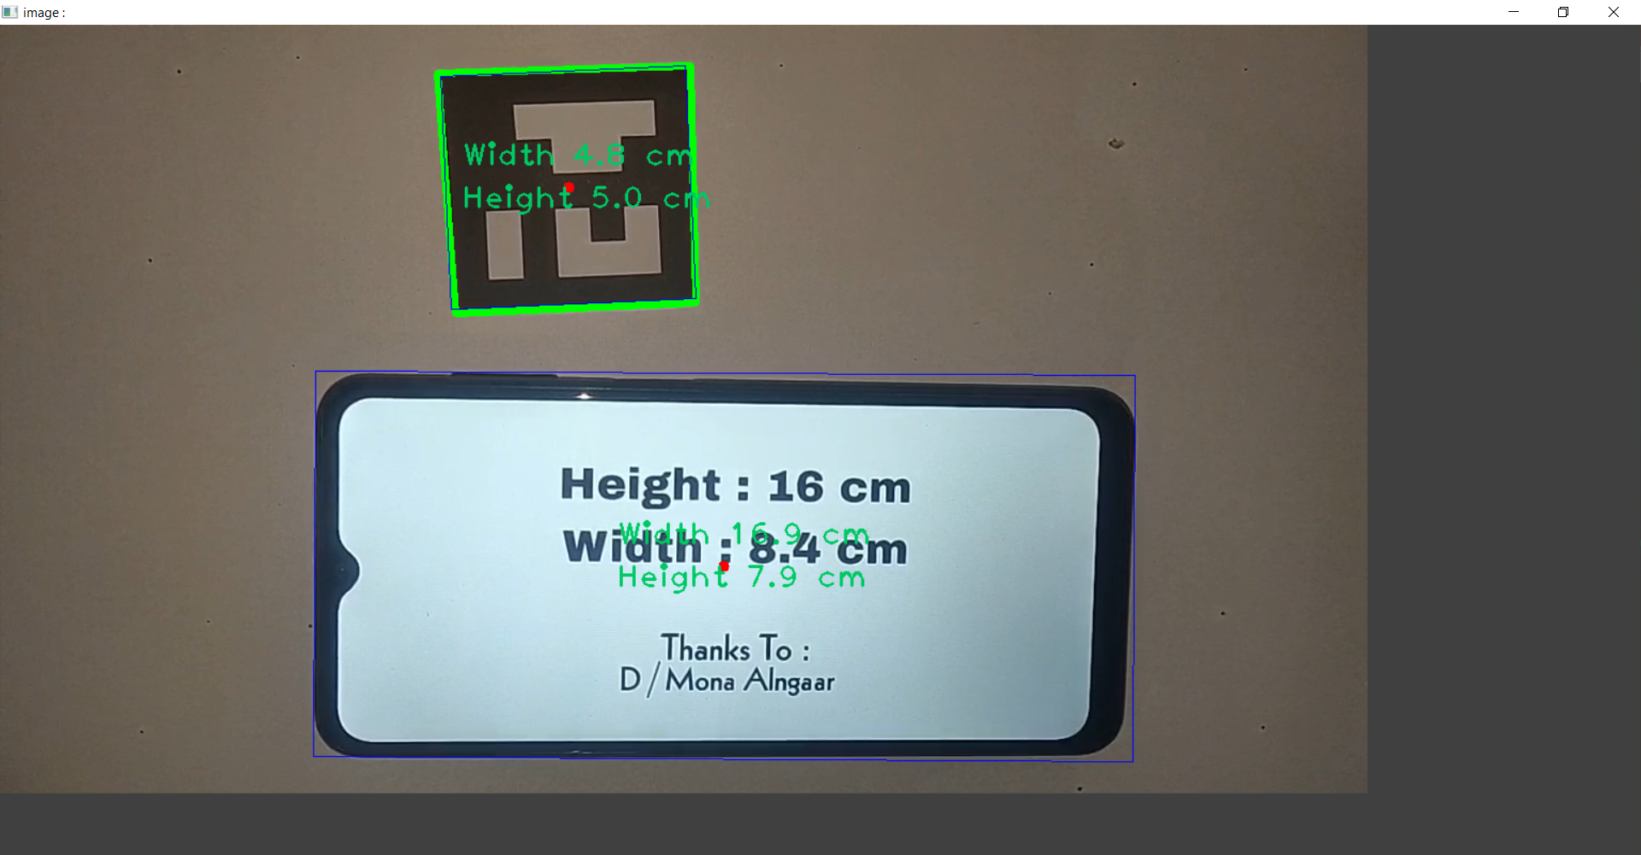
Some ReSULT

Slide 6
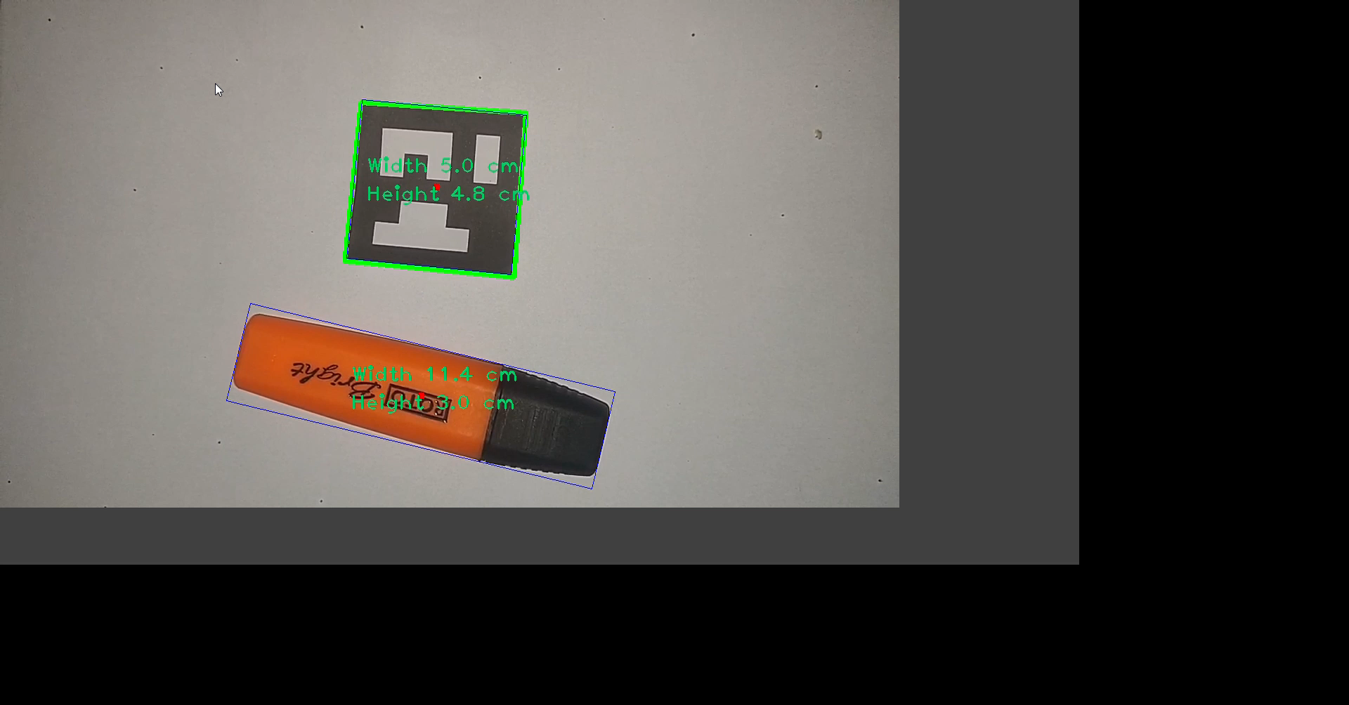
Some ReSULT

Slide 7

Future Steps:
Enhancing analysis and transformation accuracy.
Adding additional features like contrast and brightness control.
Expanding practical applications of the project.

Slide 8

Made By
عبدالرحمن احمد محسوب
عبد الودود محمد عادل شاكر نتشه
احمد الشيخ
عمار ابو سن
احمد اشرف الضويني

Slide 9
THANK YOU

